Slide 1
AWS

Slide 2
WHY AWS?
AWS is leading the pack in almost every aspect. According to Gartner, Amazon’s cloud is 10 times bigger than its next 14 competitors, combined! This is bad news for the folks at Azure and Google Cloud Platform but it is great news for you.
Whether you’re a web developer, a database admin, a system admin, an IoT developer, a Big Data analyst, an AI developer (and the list goes on and on), your life will be made much easier if you take advantage of Amazon’s platform.

Slide 3
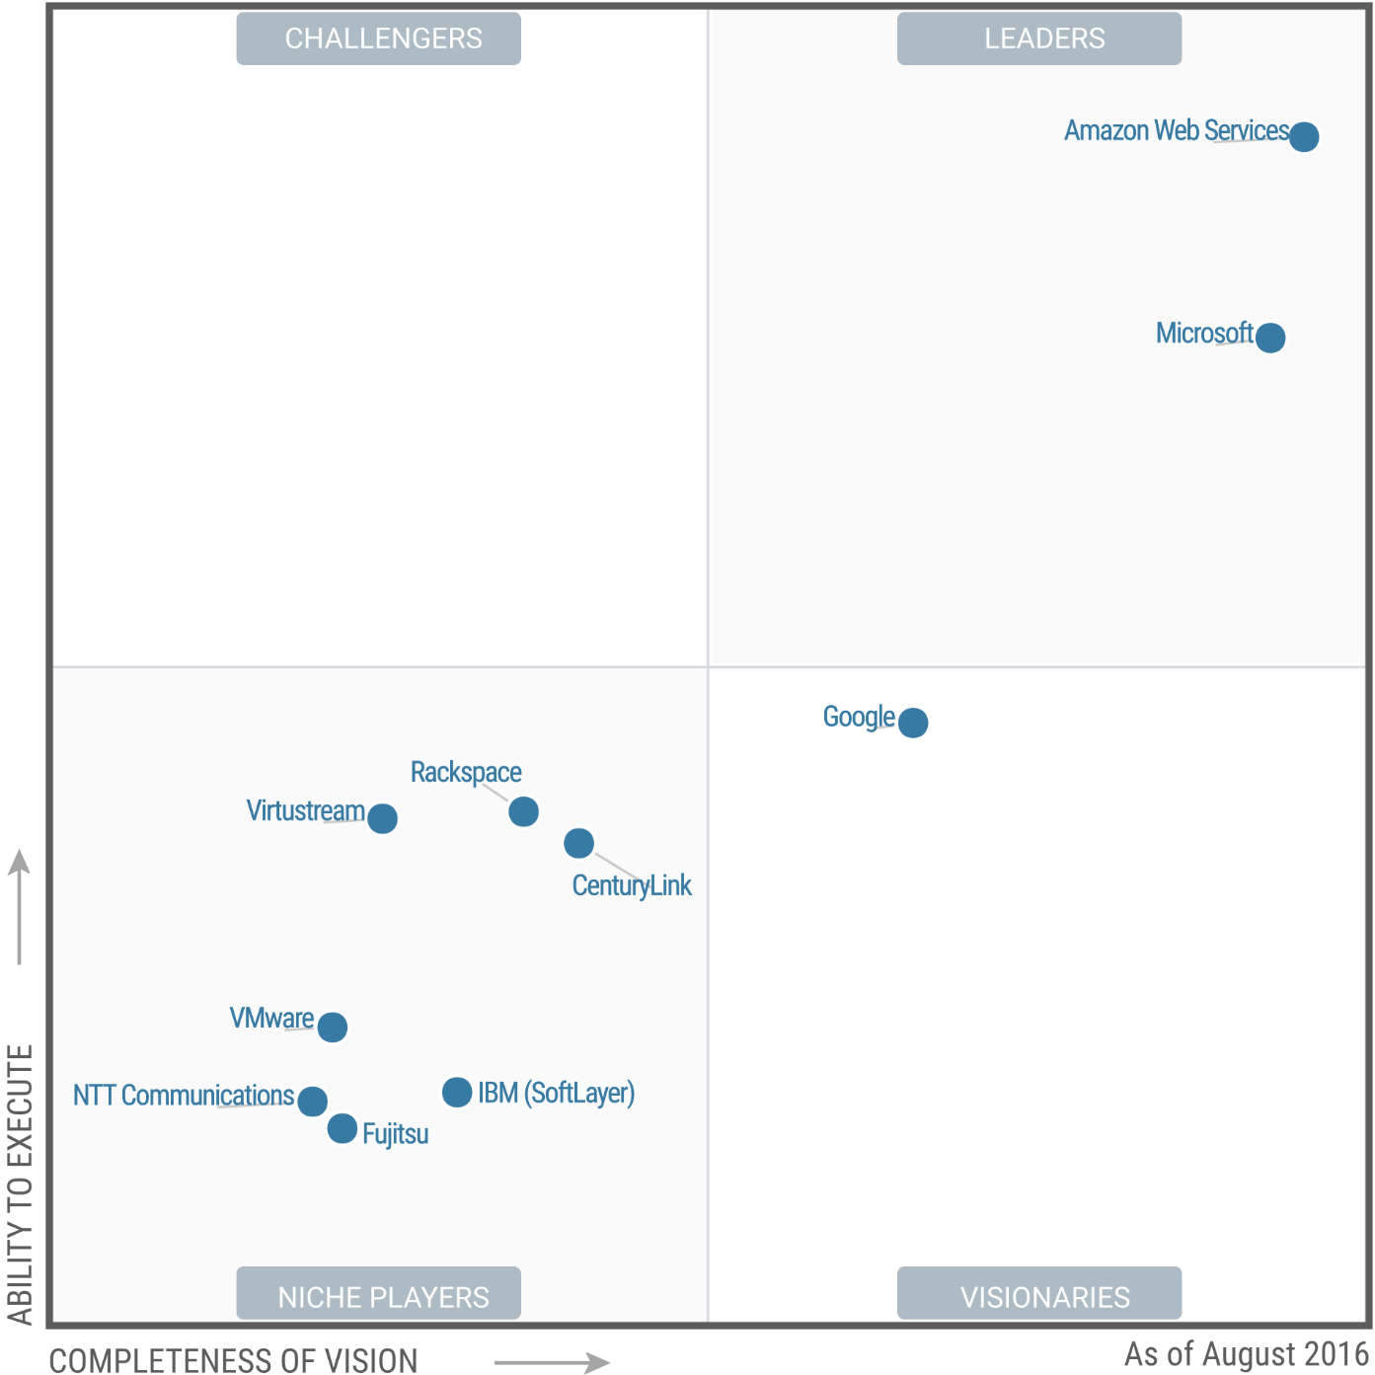
GARTNER’s MAGIC QUADRANT

Slide 4
AWS Certifications Are they feasible?
Unlike other vendors, Amazon offers a realistic certification path that does not require highly specialized (and expensive) training to start. I am not saying that it is very easy to get certified, but you won’t have to quit your job and pay for expensive training to get your first AWS certification.

Slide 5
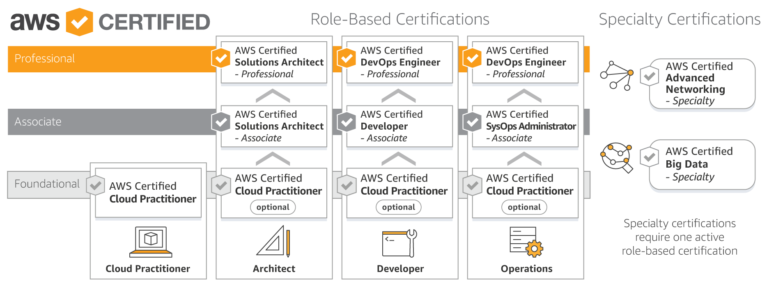
WHAT ARE ALL THE CERTS OFFERED BY AMAZON?

Slide 6
AWS IN THE MARKET? WHAT ARE ITS SCOPES? WHAT IS THE SALARY?
According to Forbes, these are the top paying certifications for 2018 :
Certified in Risk and Information Systems Control (CRISC) - $131,298
Certified Information Security Manager (CISM) - $128,156
AWS Certified Solutions Architect – Associate - $125,091
Certified Information Systems Security Professional (CISSP) - $121,729
Project Management Professional (PMP®) - $119,349
Certified Information Systems Auditor (CISA) - $115,471
Citrix Certified Professional – Virtualization (CCP-V) - $105,086
ITIL® v3 Foundation - $103,408
VMware Certified Professional 5 – Data Center Virtualization (VCP5-DCV) - $102,962
Citrix Certified Associate – Networking (CCA-N) - $102,598

Slide 7
CONCLUSION
With that being said, please remember that simply getting the AWS Solutions Architect certification DOES NOT automatically mean that you will be making the annual salary indicated in the table above. Many other factors are at play here, including your other skills, experience, geographic location, etc. The point is, proving to potential (or existing) employers that you are competent in using Amazon’s cloud offerings will have a great positive impact on your career.

Slide 8
Locally
Motherboard
SMPS
HDD 5400rpm-7200rpm/SSD-10000 IOPS
RAM
Disk Drive
Cabinet
Back Panel
LAN Ports
Headphone Ports
USB Ports
Processor – intel i3,i5,i7 – generations
Operating Systems
Cloud – EC2 = Elastic Cloud Compute
1vCPU – Virtualization
1GB RAM
8gb SSD – 10000 IOPS
Network Config – Security Groups – Firewall
On What ports should I allow Traffic – SSH , HTTPS, HTTPS, RDP, MYSQL.
Amazon Linux AMI –
OS / AMI
OS – Necessary software that you need to work on day to day basis
AMI – Software – OS + Bundled applications/packages jdk,python,pip,aws-cli

